Slide 1
CHARLIPLEXING USING RASPBERRY PI
BATCH-21
181FA04014
181FA04058
181FA04139

Slide 2
CONTENTS:
Introduction
Motivation for selecting project
Components required
Component description
Circuit diagram
Plan of action

Slide 3
INTRODUCTION:
Charlieplexing is a technique of controlling many leds using a few I/O pins. Charlieplexing is same as multiplexing, but it uses the tri-state logic (high, low input) to reduce the number of pins dramatically and to gain efficiency over multiplexing. The charlieplexing technique is named after its inventor, Charlie Allen, who invented the technique in 1995. Charlieplexing allows you to control N * (N – 1) leds, where N is the no of pins. For example, by using 3 pins you can control 6 leds using Raspberry pi. If you are working on a project in which you need to interface LCD display, a bunch of leds, and some sensors, then you are already out of pins. In that situation, you can charlieplex leds to reduce the number of pins.

Slide 4
Motivation for selecting project
The main objective of this project is controlling many leds using a few I/O pins.
Charlieplexing is same as multiplexing, but it uses the tri-state logic (high, low input) to reduce the number of pins dramatically and to gain efficiency over multiplexing.
The main advantage of charlieplexing is that it can be done on a medium-size microcontroller, driving more leds with fewer I/O pins, and potentially no external hardware besides the leds.

Slide 5
COMPONENTS REQUIRED:
Raspberry pi
LED (6)
3 Resistor (330 ohms)
Jumper Wires
Breadboard
USB cable
SOFTWARE TOOLS:
Raspbian OS
Language used:Python

Slide 6
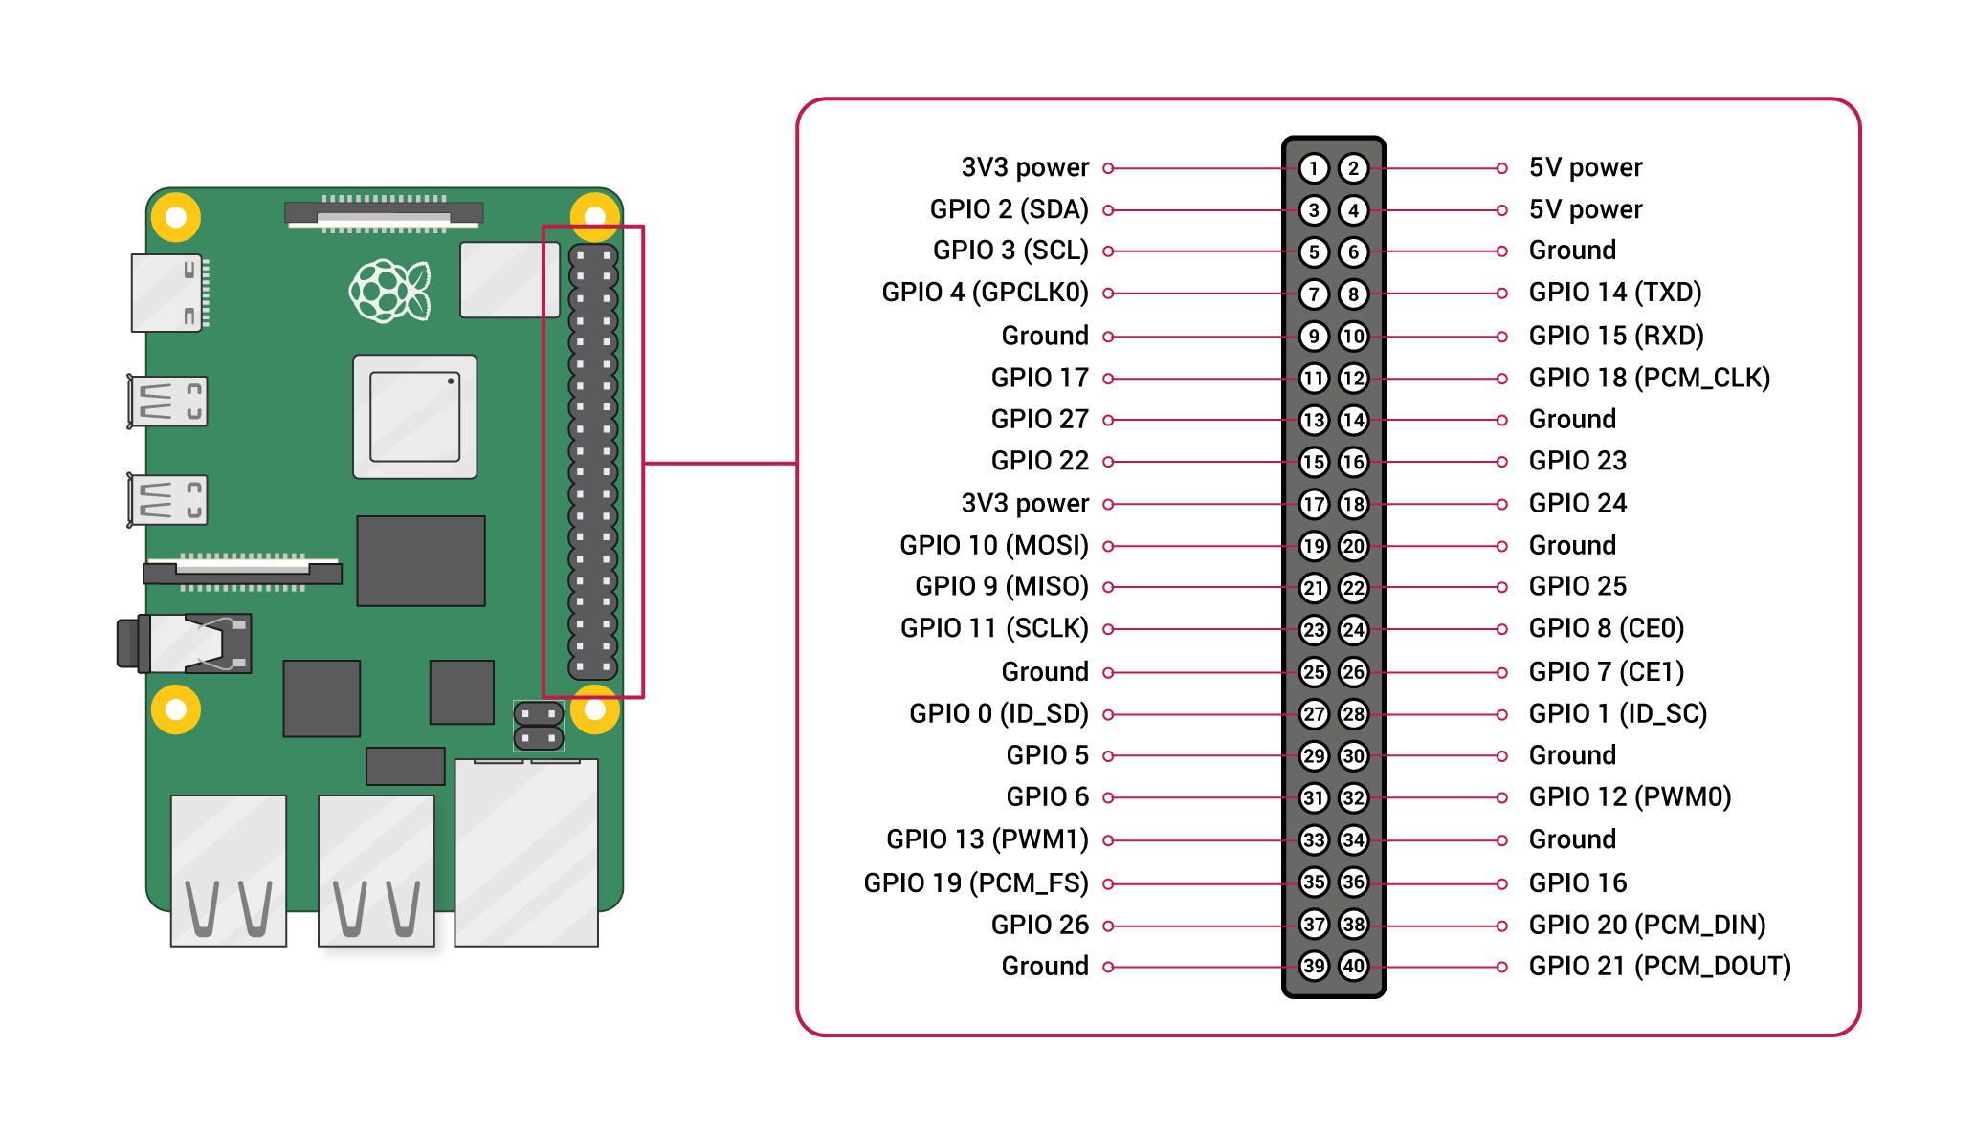
Components used :
Raspberry pi:
The raspberry pi is a low cost, credit-card sized computer that plugs into a computer monitor or tv, and uses a standard keyboard and mouse. It is a capable little device that enables people of all ages to explore computing, and to learn how to program in languages like scratch and python.

Slide 7
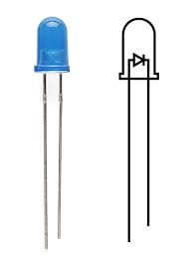
LED
A light-emitting diode (LED) is a semiconductor light source that emits light when current flows through it. Electrons in the semiconductor recombine with electron holes, releasing energy in the form of photons. The color of the light (corresponding to the energy of the photons) is determined by the energy required for electrons to cross the band gap of the semiconductor. White light is obtained by using multiple semiconductors or a layer of light-emitting phosphor on the semiconductor device.

Slide 8
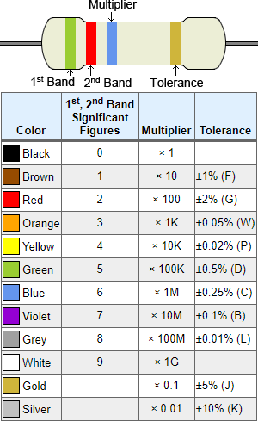
RESISTOR:
A resistor is a passive two-terminal electrical component that implements electrical resistance as a circuit element. In electronic circuits, resistors are used to reduce current flow, adjust signal levels, to divide voltages, bias active elements, and terminate transmission lines, among other uses.

Slide 9
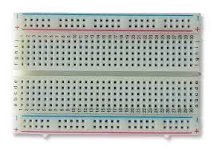
Bread board
A breadboard is a solder less device for temporary prototype with electronics and test circuit designs. Most electronic components in electronic circuits can be interconnected by inserting their leads or terminals into the holes and then making connections through wires where appropriate. The breadboard has strips of metal underneath the board and connect the holes on the top of the board. The metal strips are laid out as shown below. Note that the top and bottom rows of holes are connected horizontally and split in the middle while the remaining holes are connected vertically.

Slide 10
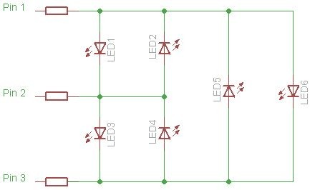
CIRCUIT DIAGRAM:

Slide 11
Plan of completion:
Initially we need to gather all the requirements required for the project .
Based on the objective of the project design the circuit diagram.
Based on the circuit diagram design a model.
Connect the hardware components together and write code.
Connect the hardware and software to get the desired model.

Slide 12
Thank you

